Slide 1
Uvod u razvoj 3d
aplikacija

Slide 2
3d Api
OpenGL
D3d
Mantle
Vulkan
WebGL
...

Slide 3
3d Api
Application programming interface for rendering 2d or 3d vector graphics
Used to interact with GPU ( graphics processing unit ), to achieve hardware-accelerated rendering.

Slide 4
GPU
Specialized electronic circuit designed to rapidly manipulate and alter memory to accelerate the creation of images in a frame buffer intented for output to a display buffer
Modern GPUs are very efficient at manipulating computer graphics and image processing, and their highly parallel structure makes them more efficient than general-purpose CPUs for algorithms where the processing of large blocks of data is done in parallel.

Slide 5
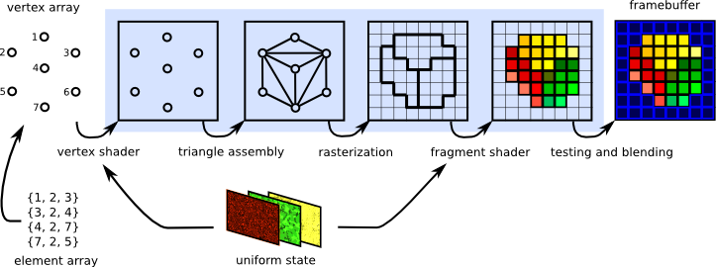
GPU Pipeline
sequence of steps used to create a 2D raster representation of a 3D scene.

Slide 6
OpenGL – fixed pipeline
Early days of opengl and graphics
Build in functions
Hard-coded lighting, transformation etc...
Removed from OpenGL 3.2

Slide 7
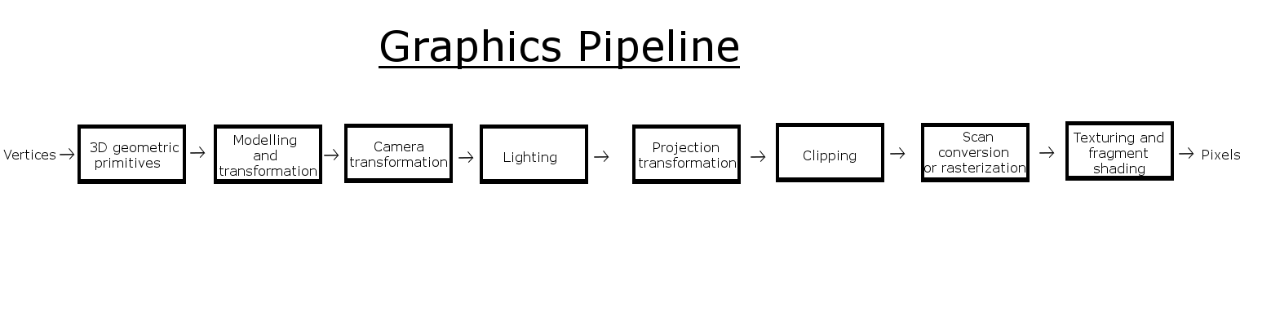
Fixed pipeline

Slide 8
OpenGL – programmable pipeline
Introduces shaders ( programs that run on GPU )
Vertex shader - deals with vertex, color, texture coordinates
Fragment Shader or Pixel Shader - deals with individual pixels
Geometry Shader – deals with assembeled primitives

Slide 9
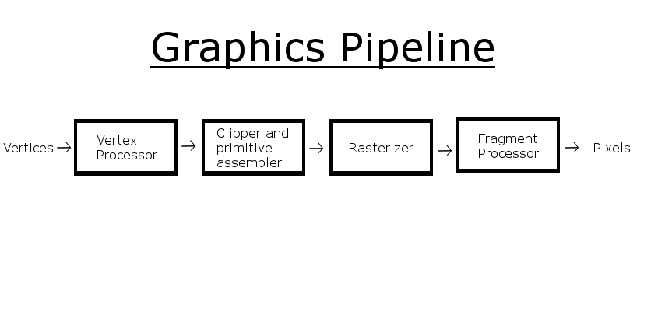
Programmable pipeline

Slide 10
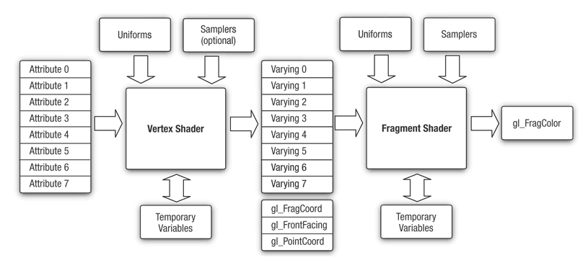

Slide 11
Code ?

Slide 12
Hvala

Slide 13


